Slide 1
The Visionaries
Midterm Report
Winter 2018
Brian Wiltse and Kien Tran (Group 3)

Slide 2

Agenda
Project Overview
Brian’s Work
Census Tract Demographics
Incident Counting
Focusing on Response Area
Kien’s Work
Conclusion and Next Steps
Brian Wiltse
(503) 507-0134
wiltseb@oregonstate.edu

Slide 3
Our Project
Project: Code3 Visionary
Client: Levrum Data Technologies
Problem: Command-level personnel need to know what resources they will need in order to respond to emergencies in their jurisdiction.
Goal: Predict the number and types of emergency incidents in a given time and place.
Method: Use demographic and incident data to inform statistical analyses and to train a machine learning algorithm to generate predictive models.

Slide 4
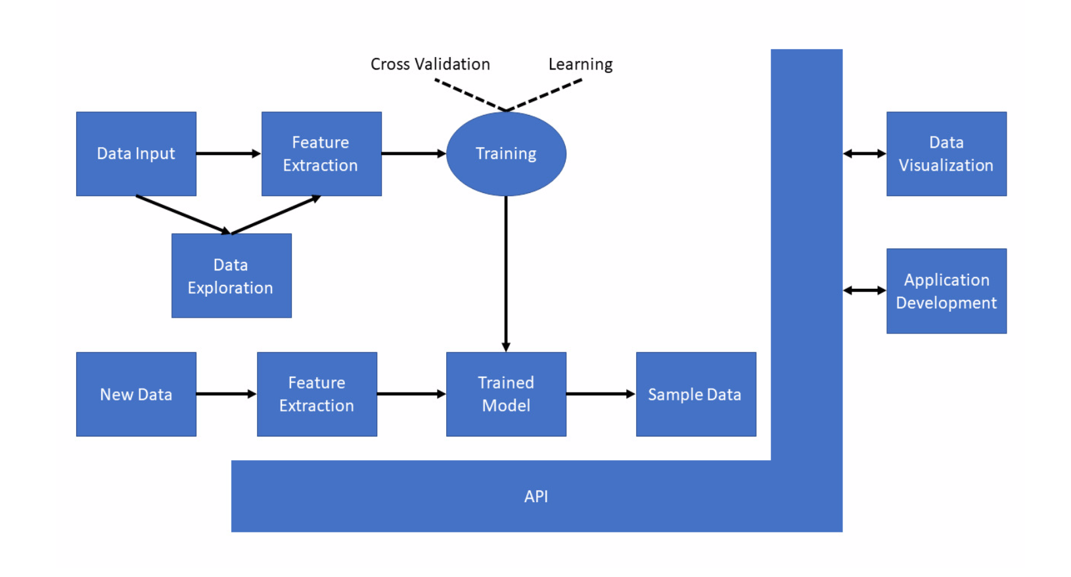
Code3 Visionary Components

Slide 5
Data Ingestion: Census Tract Demographics
Goals:
Isolate a target county in a Census shapefile (state-level) .
Append demographic information onto its attribute table.
Purpose:
Obtain information about a geography that approximates an emergency response area.
Begin to consolidate information (demographics) we need for analysis.
Note: Also implemented for block-group-level granularity.

Slide 6
Data Ingestion: Incident Counts
Goal: Attribute counts of various incident types to each shape (tract or block group) within the county.
Purpose: Acquire and consolidate more information needed for analysis.

Slide 7
Data Ingestion: Focusing on Response Area
Problem: Correlation between population and Emergency Medical Services ( EMS) calls was much lower than expected.
Probable cause:
Response area is smaller than the county.
Some tracts contribute their population with incident count of zero.
Solution: Clip / intersect county shapefile with response area shapefile.

Slide 8
References
Software used for Brian’s demonstrations: QGIS v. 2.18.15. https://qgis.org/en/site/
Notes:
PLEASE PUT THIS AT END

Slide 9

Overview
Project Overview
Brian’s Work
Census Tract Demographics
Incident Counting
Focusing on Response Area
Kien’s Work
Statistical Analysis
Machine Learning
Conclusion and Next Steps
Kien Tran
trankie@oregonstate.edu

Slide 10
Statistical Analysis
Regression Analysis Looking at R-square values
Ordinary Least Squares (OLS)
Geographically Weighted Regression (GWR)
Building a baseline

Slide 11
Machine Learning
Creating model that best represents regression
Testing models against baseline
Tested models: Google TensorFlow
Others: Pytorch

Slide 12
Conclusion / Next Steps
Picking variables to generate baseline
Develop machine learning model and test
Create simple user interface (UI)

